Slide 1
Intellitune
Automatic ham radio antenna tuner
Notes:
Preston

Slide 2
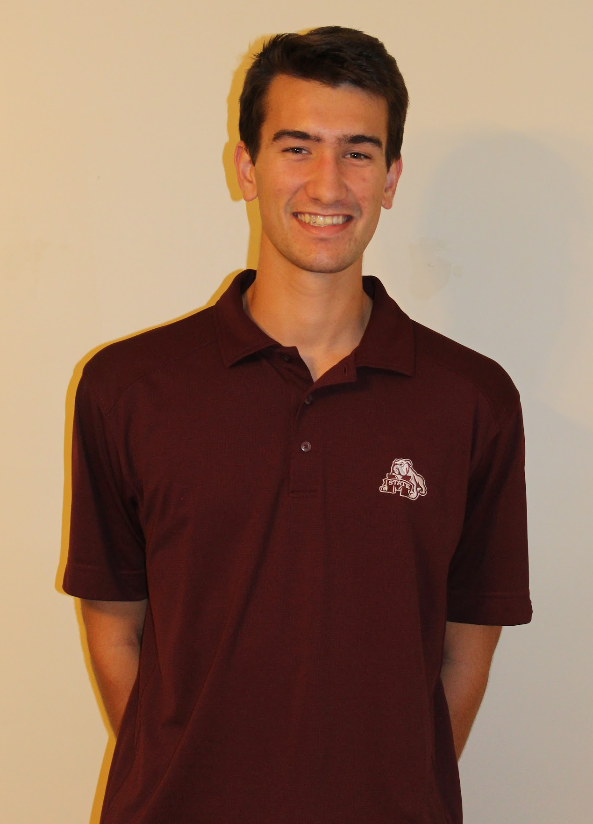



Team Members
Preston Peranich
Jonah Stevens
Haley Knable
Noah Ihediwa
Electrical Engineering
Team Lead
Electrical Engineering
Electrical Engineering
Electrical Engineering
Notes:
All

Slide 3

Faculty Advisor
Education/Qualification
BS, Electrical and Electronics Engineering, Bogazici University, 2003
MS, Electrical and computer Engineering, George Washington University, 2005
PhD, Electrical and Computer Engineering, George Washington University, 2009
Relevant Research and Interest
RF Sensors and Systems
Antennas and Computational Electromagnetics
Dr. Mehmet Kurum
[1]
Notes:
Jonah

Slide 4
Team Member Roles
 | Hardware Design | Hardware Assembly | Software Design | Testing | Mounting | Integration
Preston |  |  | Lead |  |  | All
Jonah | Lead |  |  |  | Both | All
Haley |  | Lead |  |  | Both | All
Noah |  |  |  | Lead |  | All
Notes:
Jonah and Preston

Slide 5
Presentation Overview
Ham Radio Introduction
Problem and Solutions
Constraints
Technical
Practical
System Overview
System Testing
Timeline and Progress
Notes:
Jonah-20 secs

Slide 6
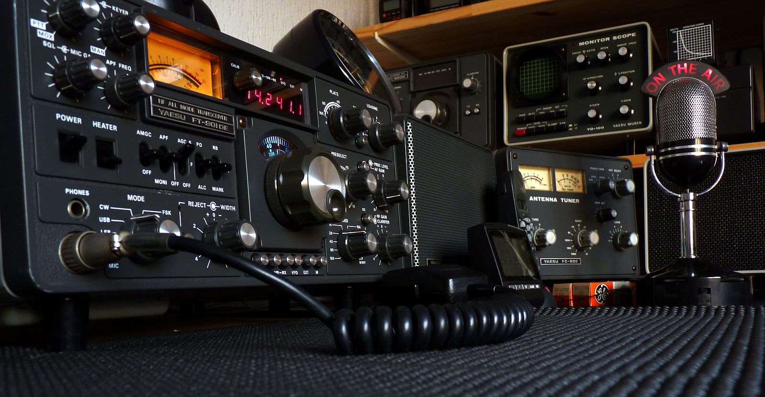
Ham Radio Introduction
[2]
Notes:
Haley - Ham radio is a hobby where operators communicate from radio to radio , without internet/cell phones. The most basic radio setup consists of a transceiver and an antenna. As the user changes the frequency that they are operating on, the antenna impedance changes, while the transceiver output impedance stays the same. However, in order to operate at maximum transmitted power it is essential that the antenna and and transceiver impedances match. 40 secs

Slide 7
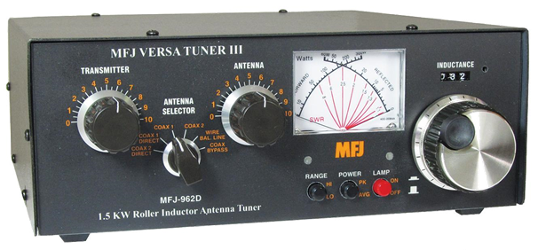
Problem
Manual tuning is time consuming and lacks precision.
Notes:
Noah

Slide 8
Solution
Intellitune will perform fast and reliable automatic tuning.
Notes:
Noah

Slide 9
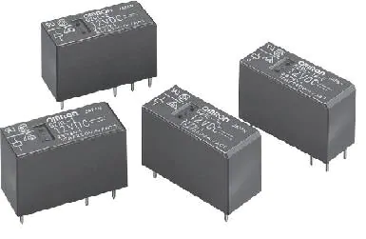
Problem
Discrete components leave room for lack of precision
Current automatic tuning units employ many relays that burn up over time
Notes:
Noah

Slide 10
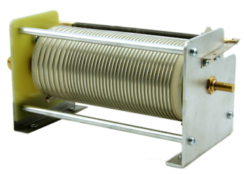
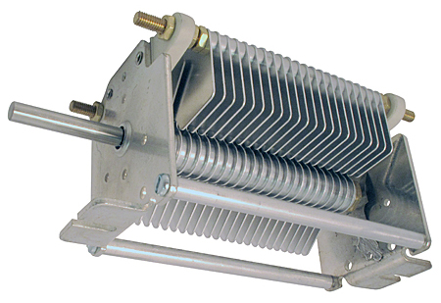
Solution
Intellitune utilizes variable components that can be adjusted to precise values of impedance
Design contains significantly less relays
Notes:
Noah-all problem and solution slides(51)

Slide 11
Technical Constraints
Name | Description
Power Rating | Handle 1.5 kW of power
Bandwidth | Pass through frequencies from 1.5 MHz to 30 MHz
VSWR Sensing | Determine the voltage standing wave ratio (VSWR) up to a 32:1 mismatch.
Frequency Sampling | Sample the transmitting signal and determine frequency up to 30 MHz
Impedance Matching | Provide a tuning network that can match impedances from 12-1600 ohms
Notes:
Jonah - Power Rating, Bandwidth, VSWR Sensing why (30 s)
Noah - Frequency Sampling, Impedance(15 s)

Slide 12

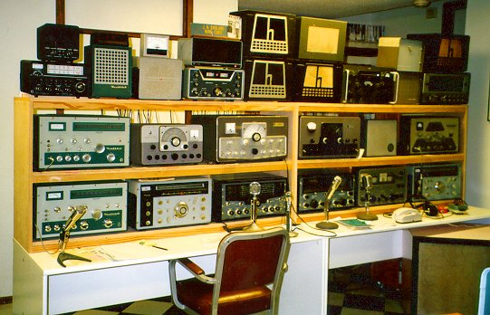
Practical Constraints
User Safety [4]
Product Size [5]
Notes:
Haley - (50 s) The two main practical constraints that need to be taken into consideration are user safety, and product size. User safety is critical for a product like intelletune that is capable of handling 1.5 kilowatts. The product must be manufactured with safety in mind so that the front panel , as well as the rest of the enclosure is safe to be touched.
Ensuring user safety is critical, so the auto tuner must not pose any potential risks to users during operation. The Intellitune may handle up to a 1.5 kW load, but this high load presents the risk of electrocution. The design must ensure that all potentially dangerous RF current is isolated from the enclosure surface. Therefore, the Intellitune must be placed in a durable yet lightweight enclosure that provides adequate grounding so surface charge does not accumulate.
The second constraint that must be kept in mind is the physical size of the enclosure. A ham radio operator typically has a work-bench, or desk, with many different modules that perform different tasks in their set up. The Intellitune must remain competitive be compact enough so that users do not avoid it due to being oversized. A safe constaint for Intellitune is to keep it within 2 inches either direction of a similar existing model that is 13x7x16

Slide 13
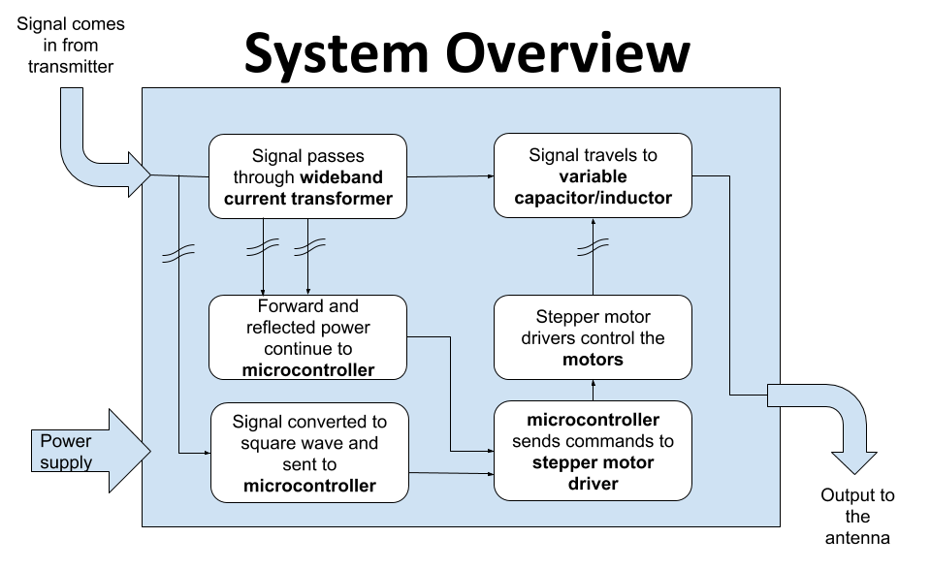
Notes:
Preston- 47

Slide 14
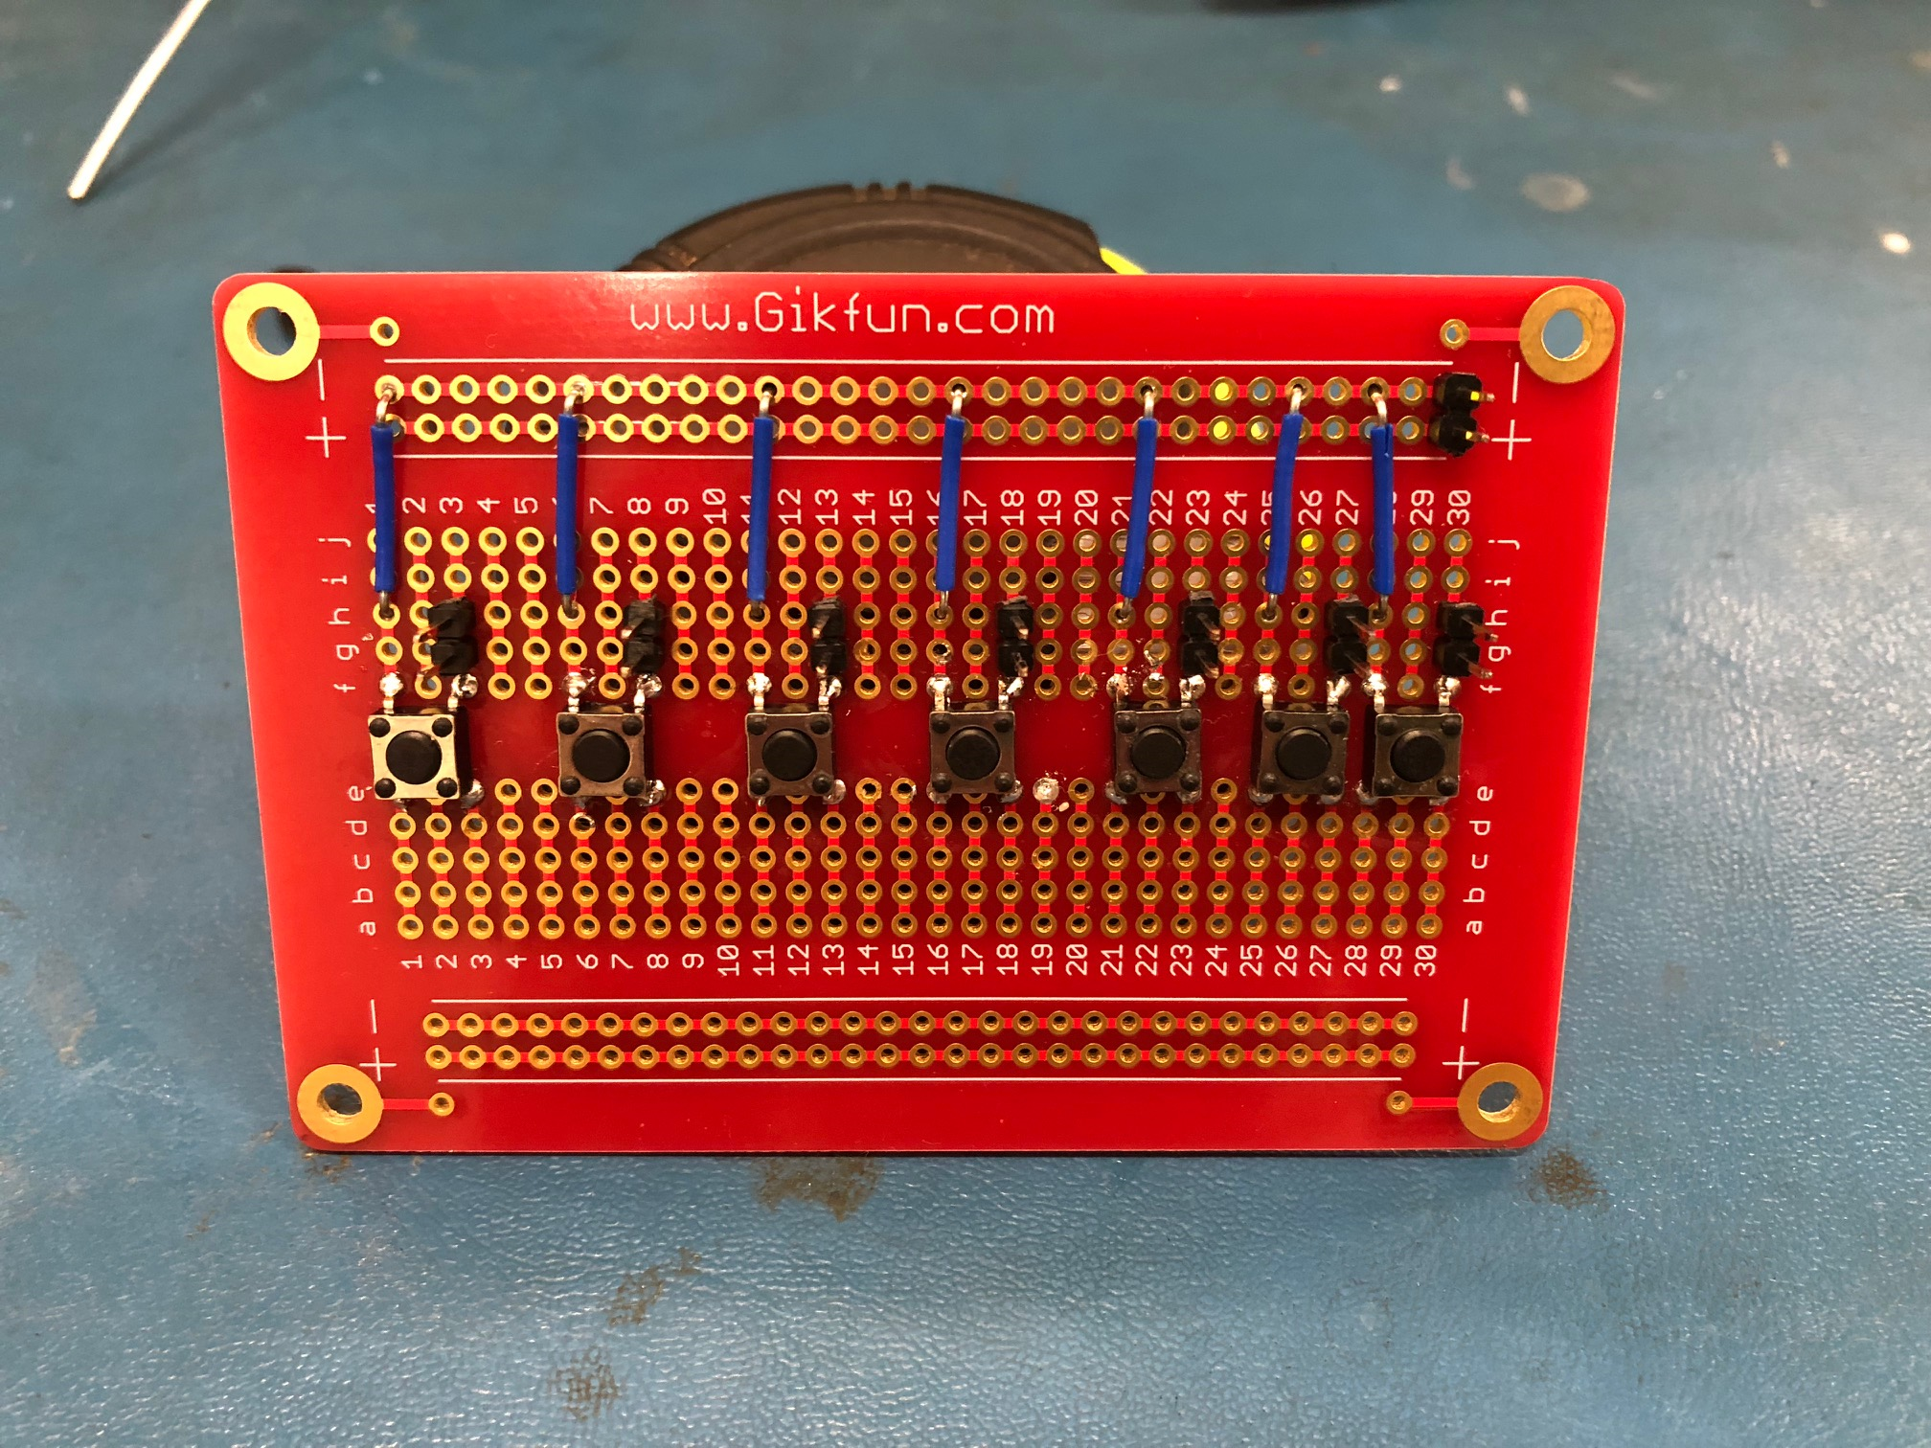
User Interface
Display shows
SWR reading
Current tuning values
frequency
Test Procedure:
Pressed Buttons and monitored for correct operation L/C-Up/Down, Mode, Tune
Notes:
Jonah - features seven buttons triggered by a push 22

Slide 15
Voltage Standing Wave Ratio (VSWR) Sensor
Performed by the wideband current transformer
Test procedure:
Connect 50 ohm load to calibrate for 1.0 SWR
Monitor digital potentiometer to verify proper voltage scaling.
Test with varying known loads and verify experimental reflection coefficient close to the theoretical value.
Notes:
Preston - 51

Slide 16
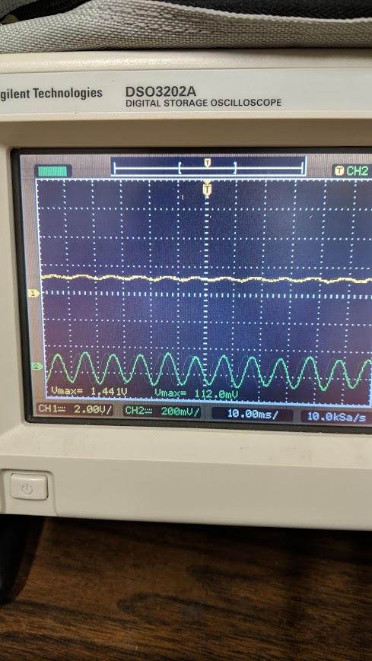
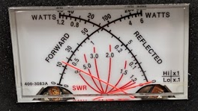
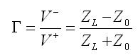
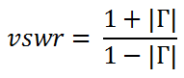
VSWR Sensor Test Data
Resistance | Expected SWR | External SWR Reading | Intellitune SWR Reading | % Error
50 Ohm | 1.0 | 1.1 | 1.168 | TBD
100 Ohm | 1.71 | TBD | TBD | TBD
25 Ohm | 1.71 | TBD | TBD | TBD
Notes:
v max ch 1 = 1.44 and other 112 mV …….. (.112/1.44 +1 )/(1- .112/1.44) …. SWR = 1.168

Slide 17
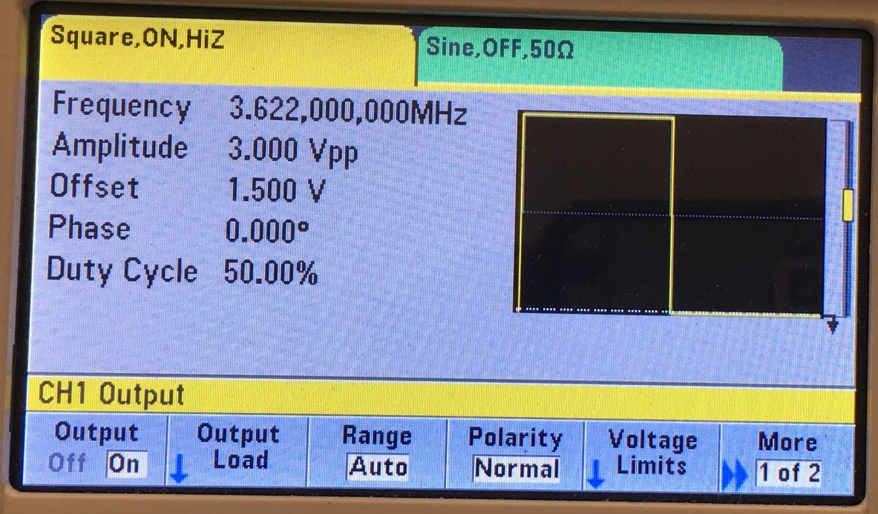
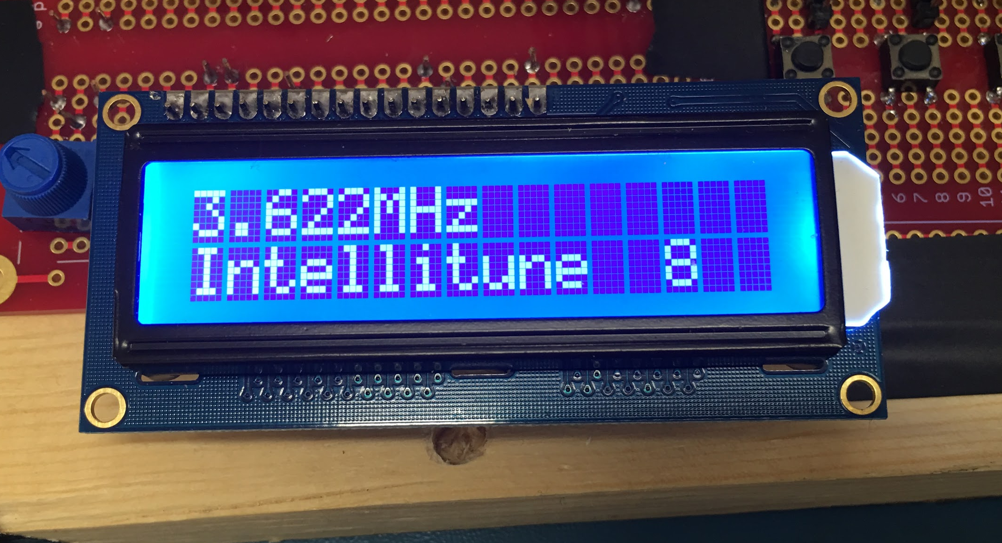
Frequency Sampling
Samples transmitted signal and measures frequency up to 30 Mhz
Notes:
Noah - 30
One kHz precision
Test procedure: signals of various voltages and frequencies are sent to the frequency counter, and its measurements are displayed on the LCD

Slide 18
Frequency Sampling Test Cases
Frequency Generated | Waveform Type | Voltage (Vpp) | Frequency Sampled
3.622 MHz | sine | 3.00 | 3.622 MHz
3.622 MHz | square | 3.00 | 3.622 MHz
19.15 MHz | sine | 4.00 | 19.15 MHz
19.15 MHz | square | 4.00 | 19.15 MHz
Notes:
Noah

Slide 19
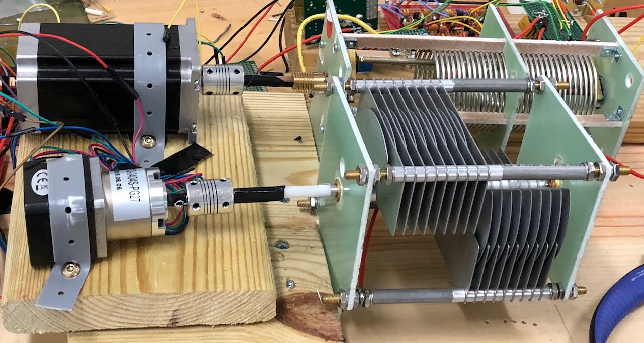
Stepper Motor Subsystem
Test Procedure:
Rotate motor without connection to components
Rotate motor with connection to components
Check final position of variable components against anticipated
Notes:
Haley - 30 …. by that we mean to ensure that there’s no slipping between the variable components

Slide 20
Impedance Matching Code
Code that will calculate tuning network values
Test Procedure:
Input dummy reflection coefficients to verify algorithm calculations
Connect known dummy loads and verify correct load and SWR are calculated
Verify motors adjust to calculated tuning values
Notes:
Preston - 36

Slide 21
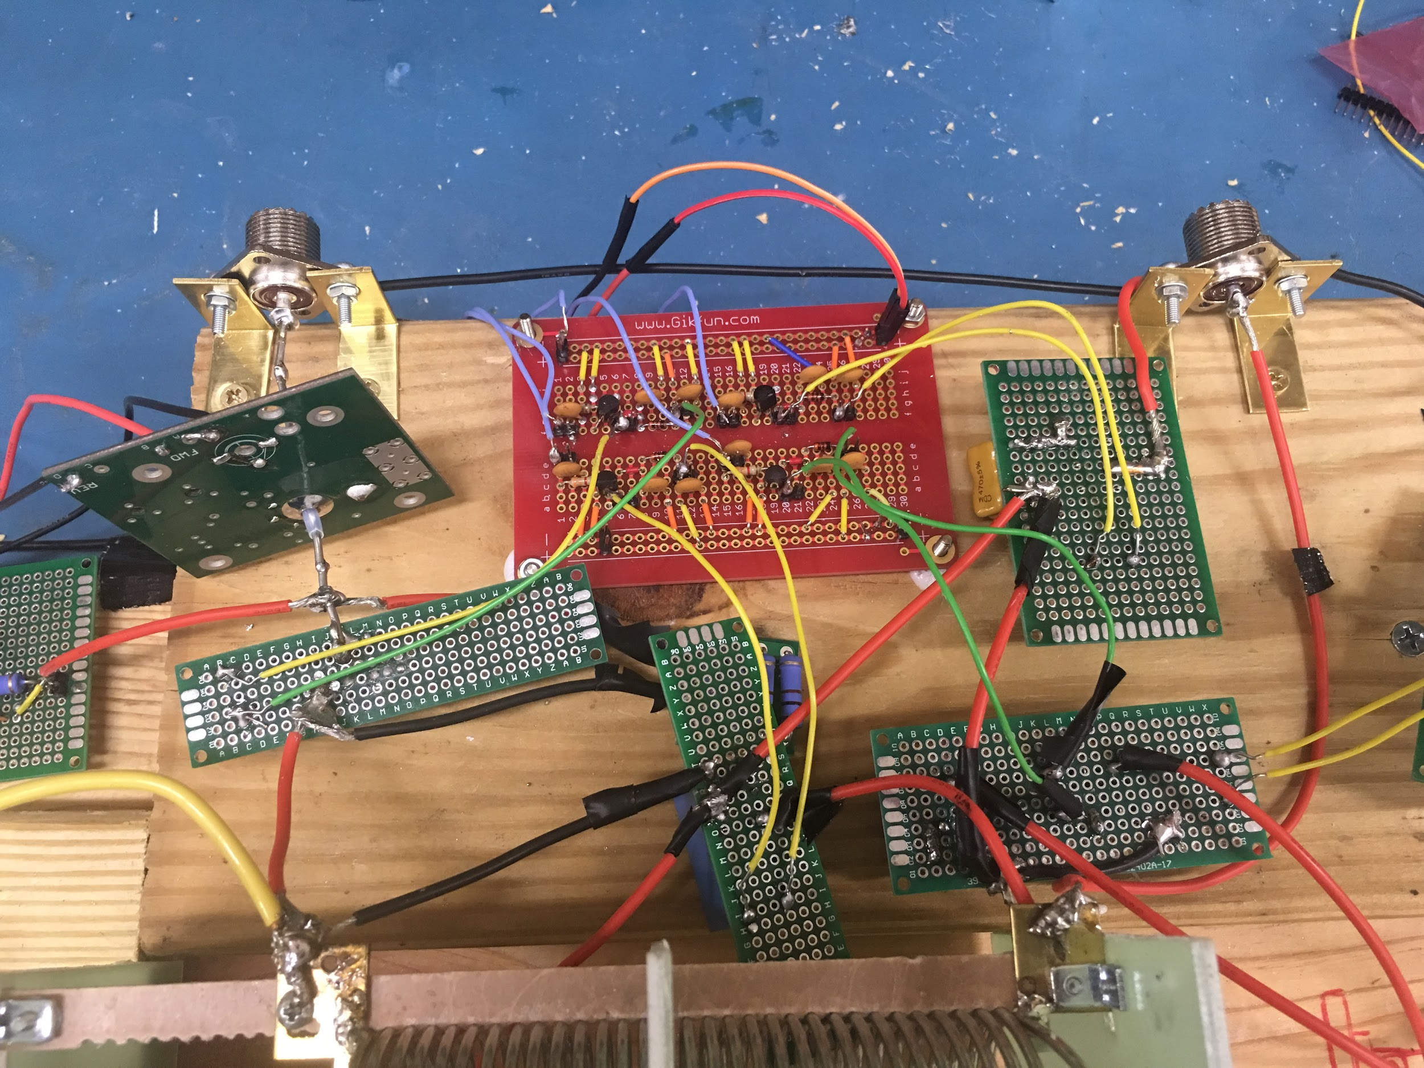
Relay Circuit Subsystem
Test relay functionality
and consistent driver
circuit assembly
Test Procedure:
Switch in known impedance (25 ohm resistor)
Switch in different capacitor sequence
Switch capacitor bank position
Notes:
Jonah

Slide 22
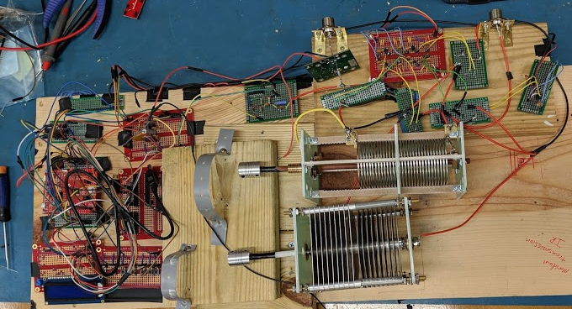
System Test
Notes:
Noah

Slide 23
System Test
Test Procedure:
Place Intellitune between transceiver and dummy load
Transmit FM signals at different frequencies and powers based off test cases
Start tuning process upon button press
Compare real data to expected
Notes:
Noah

Slide 24
System Test
Test Cases
Frequency | Transmitted Power | Load | Initial SWR Expected | Final SWR Expected | Actual Initial SWR | Actual Final SWR
2 MHz | 5 W | 100 ohms | >2 | <2 | TBD | TBD
5 MHz | 10 W | 100 ohms | >2 | <2 | TBD | TBD
9 MHz | 12 W | 100 ohms | >2 | <2 | TBD | TBD
10 MHz | 15 W | 100 ohms | >2 | <2 | TBD | TBD
Notes:
Haley Knable - stray capacitance becomes a bigger issue at higher imp

Slide 25
Timeline
8/18
9/18
10/18
11/18
Initial Research
Design
Phase
Subsystem Development
Integration + Debug
Technology learned
Drew schematics and ordered components
Piecing together the subsystems
Finalizing the product
Notes:
Haley - 30

Slide 26
Progress
All subsystems have been completed
User interface
VSWR Sensing
Frequency counter
Variable component location sensing
Stepper motor subsystem
Impedance matching code
Notes:
Haley - 40

Slide 27
Future Work
Debugging the system
Notes:
Preston

Slide 28
References
[1] “Dr. Mehmet Kurum,” www.ecemsstate.edu, [Online] Available: http://www.ece.msstate.edu/people/faculty/dr-mehmet-kurum/. [Accessed: 1-Oct-2018].
[2] “Create a Spiral Dipole Antenna for a ham Radio,” formufit.com. [Online] Available: https://formufit.com/blogs/news/create-a-spiral-dipole-antenna-for-ham-radio. [Accessed: 1-Oct-2018].
[3] MFJ Enterprises, Inc., Starkville, MS, USA, “MFJ-998,” Available: https://www.mfjenterprises.com/Product.php?productid=MFJ-9982 . [Accessed: 18 Sep. 2018].
[4] “ISO Electrical Shock - Electrocution Warning Sign Symbol, SKU: IS-2026,” MySafetySign.com. [Online]. Available: https://www.mysafetysign.com/electrocution-symbol-triangle-warning-sign/sku-is-2026. [Accessed: 16-Oct-2018].
[5] “More Links,” WW2 Navy Radio - The Radioman's Job. [Online]. Available: http://www.virhistory.com/ham/ . [Accessed: 04-Oct-2018].

Slide 29
Intellitune
Automatic ham radio antenna tuner

